Slide 1
Parks and Recreation
Group-Forecasters:
Eswar Hemant Majeti- G233R756
CS 896: Data Science Capstone Project
Summer 2023 (CRN 32292)
Instructor:
Dr. Fujian Yan
Fujian.yan@wichita.edu

Slide 2
Dataset Description
The Data provided consists of Facility calendar form the year 2013 to 2022.
There are 6 Facilities:
Stephen_Mason_Carnegie
Stephen_Mason_CB
Stephen_Mason_ELC
Stephen_Mason_HPC
Stephen_Mason_SPL
Stephen_Mason_UP Depot
The Data set consists of a total of 69 files
PDF: 59 Files consisting of yearly based facility calendar
XLS worksheet-10 Files consisting of yearly data of all locations

Slide 3
Variable | Type | Description
Facility Class | Categorical | There are a total of 17 classes provided Each class has one or more facilities under it.
Facility Location | Categorical | Various building locations of LPRD
Facility Code | Categorical | Assigned code for each Facility in the buildings
Facility | Categorical | The type of Facility booked for various events
Status | Categorical | Status of the reservation(Firm, Hold, Internal, Tentative)
Reservation type | Categorical | Reservation type is a variable used to describe the type of booking it is. (Facility or Activity)
Begin Time | Time | Start time of the event.
End Time | Time | End time of the event.
Begin Date | Date | Start date of the event.
End Date | Date | End date of the event.
Head Count | Numerical | Number of people attending the event.
Variables Used

Slide 4
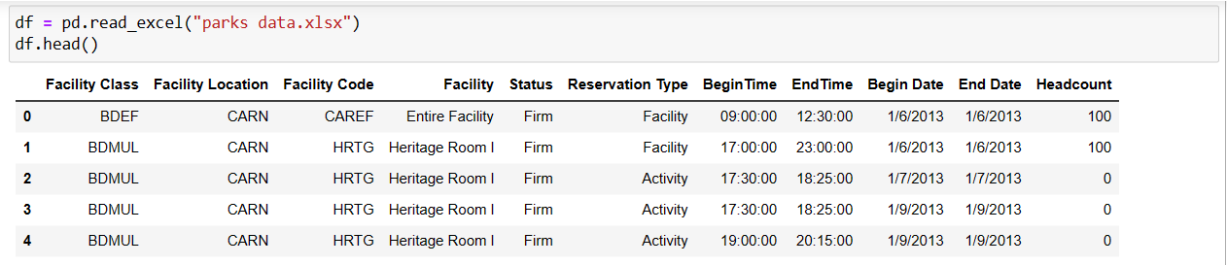
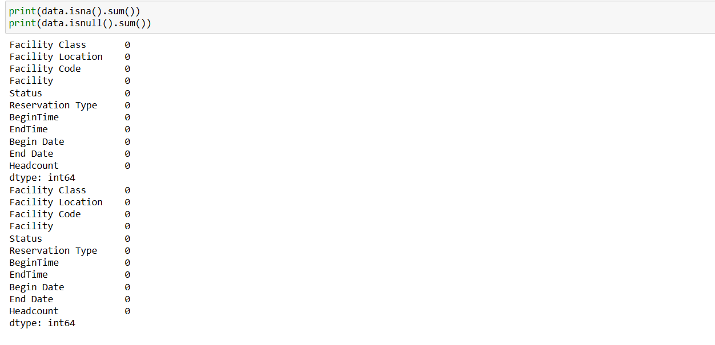


DATA PRE-PROCESSING
Size of Data set provided in Excel on yearly basis: [123649 rows x 11 columns]
2013- [8012 Rows x 11 Columns]
2014- [10632 Rows x 11 Columns]
2015- [13111 Rows x 11 Columns]
2016- [14459 Rows x 11 Columns]
2017- [15897 Rows x 11 Columns]
2018- [15536 Rows x 11 Columns]
2019- [15319 Rows x 11 Columns]
2020- [8380 Rows x 11 Columns]
2021- [9418 Rows x 11 Columns]
2022- [12885 Rows x 11 Columns]

Slide 5
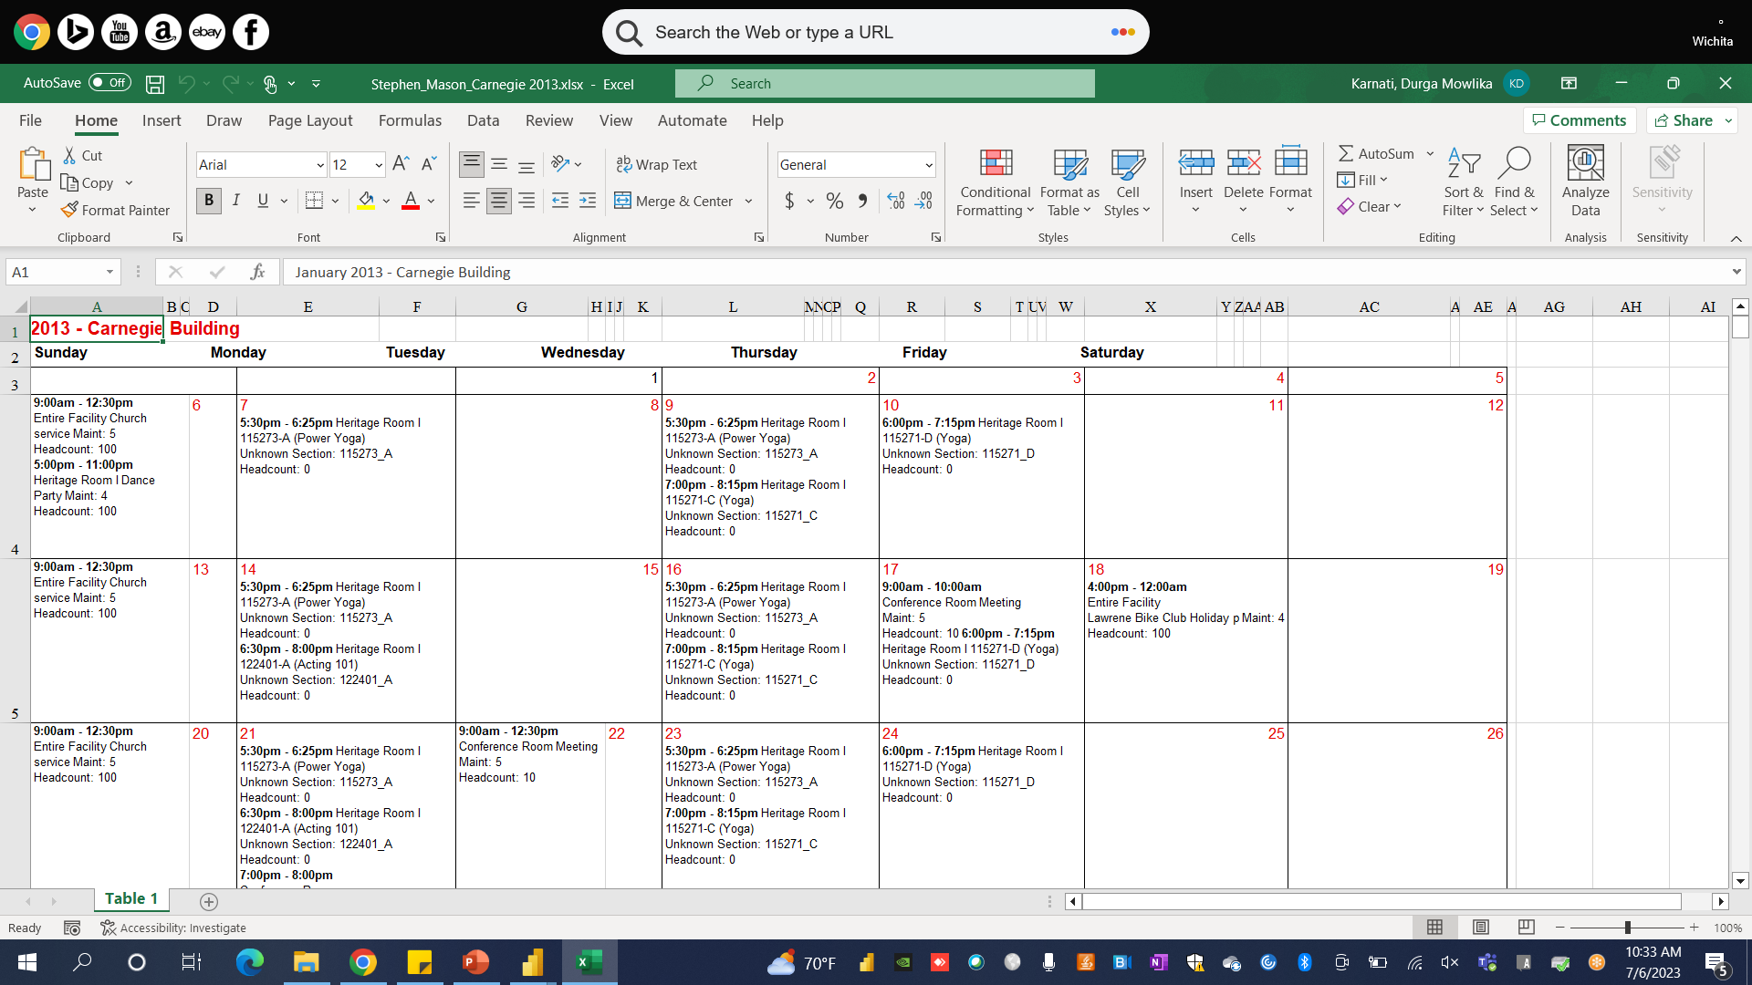
Facility Calendar

Slide 6


Related Work:
Forecasting Daily Visitors and Menu Demands in an Indonesian Chain Restaurant using Support Vector Regression Machine (Refer Here)
Chinese automobile sales forecasting using economic indicators and typical domestic brand automobile sales data: A method based on econometric model (Refer Here)
Restaurant Sales and Customer Demand Forecasting: Literature Survey and Categorization of Methods (Refer Here)

Slide 7
Forecasting Daily Visitors and Menu Demands in an Indonesian Chain Restaurant using Support Vector Regression Machine
(Makmur A Zháo; Riyanto Jayadi)
Durga Mowlika Karanti – (J953T923)
Problem Statement: To investigate menu demand forecasting in restaurants and to forecast potential visitors using point-of-sale (POS) data
Methods/Models : Time-Series analysis, Multiple Regression and Support Vector Machine

Slide 8

How the authors used the algorithms to solve the problem?
SVM & Multiple regression analysis is employed to examine the relationship between various parameters
to forecast menu demand
customer arrival time in restaurant
to forecast customer count
forecasting revenue

Slide 9

Discussion
Data Understanding (POS Data & external data such as calendar day events) – 23 parameters in total, 8 significant features were selected
Number of Visitor Forecasting Correlations (work shift)
Menu Demand Forecasting Correlations (seasonality and cook type)
Prediction Graphs for all the menus
MAPE (Mean Absolute Percentage Error)
Time Series Analysis to forecast daily visitors and menu demands.

Slide 10
Relation to the project: The forecasting models can capture and quantify the expected demand based on historical patterns and relevant factors
Booking Policy Change: Results in resource management capability
Exploring Interactions: Can reveal insights into the relationships between independent variables (Facility location, Facility Classes, Begin Date) and the dependent variables (Demand).
Deploying the models to the data sets given

Slide 11
Eswar Hemant Majeti (G233R756)
Presented by : Agnieszka Lasek, Nick Cercone & Jim Saunders
Restaurant Sales and Customer Demand Forecasting: Literature Survey and Categorization of Methods
Objective: To forecast demand for restaurant sales and maximize revenue using machine learning models.
Model used: Multiple linear regression, Poisson Regression, Box-Jenkins Model, Expontential Smoothing and Holt-Winters Model, ANN.

Slide 12

A successful restaurant yield revenue management system relies heavily on demand forecasting. In the past, the forecasting of restaurant sales has been based on subjective judgment.
The management often faces challenges in predicting variables such as time, weather, economic factors, and unpredictable situations.
Demand forecasting in Restaurant Business

Slide 13

Model Used
Here they have utilized machine learning models Like Multiple Regression, data can be leveraged to make more accurate sales predictions considering these variables.
The model can use the below variables like Time, weather, holidays, promotions, Events, Historical Data, Location type, etc.
Restaurant industry could use Revenue management (RM) with support of machine learning models to make decisions.

Slide 14

What is Revenue management (RM)
Revenue management (RM) is defined as the method to allocate the right price(in the case of a restaurant) to the right person using the available data.
Revenue management (RM) uses data, business understanding, and decision making to maximize sales.
Revenue management (RM) is widely used in the airline industry.
Ever wondered why airline tickets prices change? Part of the reason is Revenue management (RM).

Slide 15

One of the advantages of usage of regression models for demand forecast is that it can logically formulate a cause-and-effect relationship between the variables and future sales/demand.
We can build on our project by forecasting booking of the facility in the future. This will enable the management to be prepared for the case of overbooking and allocate the customers to the next best facility.
This reallocation will increase the sales and maximize the profits for the organization.
This will enable the organization to fill the facilities which are not usually booked by the customers. This way there is optimal usage of the facilities and the resources.
Why use Regression model for our dataset?

Slide 16
Unique Characteristics of the Model
Periodic updates are essential for the model as the relationship between variables undergoes constant changes.
During the pandemic, restaurants were not allowed to operate at full capacity. As a result, the maximum number of guests they could accommodate changed from the previous data. In such cases, the model needs to be updated to adapt to the changing circumstances. Another scenario where updating the model is necessary is when there is inflation.
In the same vein, when opting for a regression model for demand forecasting, it is imperative to consistently update the model throughout our project.
For instance, many organizations shifted to conducting meetings via Zoom during the lockdown, resulting in a decrease in the number of bookings. This led to data irregularities during the years 2020-2022.

Slide 17

Chinese automobile sales forecasting using economic indicators and typical domestic brand automobile sales data: A method based on econometric model
Junjie Gao1, Yanan Xie1, Xiaomin Cui1
Han Yu2 and Feng Gu1
Sudheer Kuchipudi – (A352H672)
Methods/Models:
Johansen's cointegration tests
Vector Auto Regression (VAR)
Vector Error Correction Model (VECM)
Granger-causality tests.

Slide 18

How the authors use the method, model, or algorithm to solve the problem?
The authors employ Johansen's cointegration tests to establish long-term relationships among variables.
They utilize VAR and VECM models to capture short-term dynamics and long-term equilibrium relationships.
Granger causality tests are conducted to determine the direction of influence among the variables.

Slide 19

Relation to your project. How do you want to use it?
Time Series Analysis and Forecasting (VAR and VECM)*:
'Begin Date' and 'End Date' defining the time period.
'Headcount' field can serve as data points to analyze historical patterns and forecast future demand for each facility.
Understanding Relationships Between Variables (Granger Causality test)*:
Granger causality tests can help uncover relationships between variables.
For instance, we can use this test to determine whether a facility's 'Facility Status' or 'Reservation Type' can predict its headcount.

Slide 20
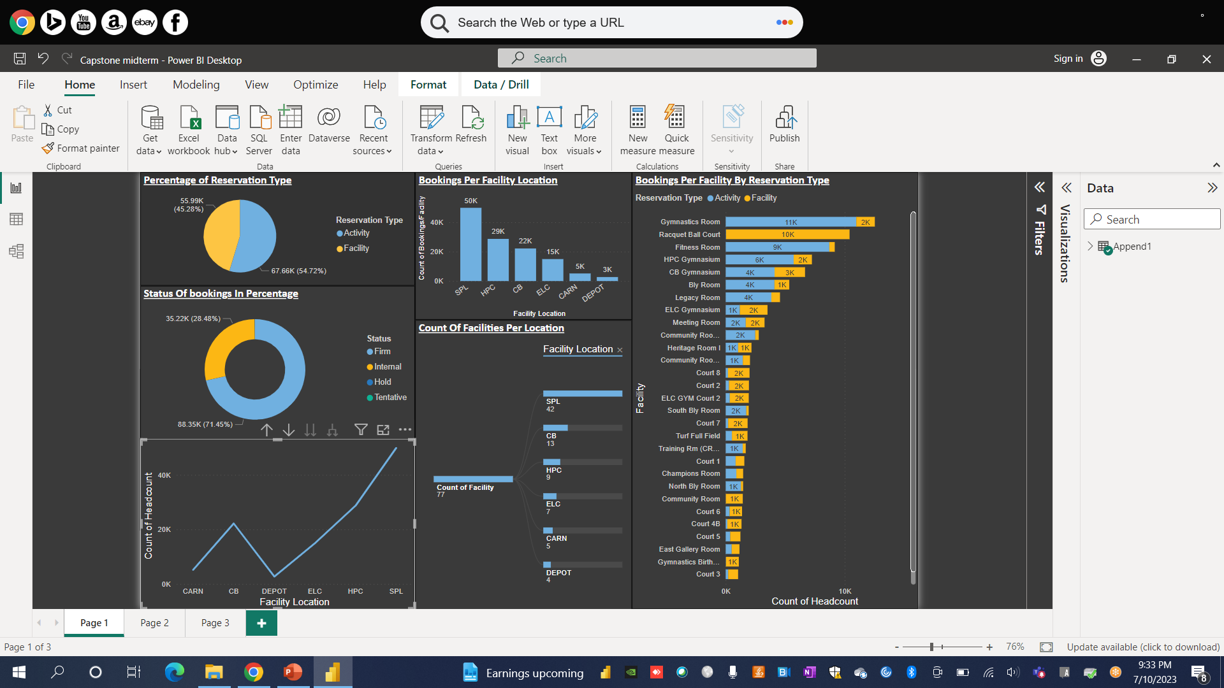
dashboard

Slide 21
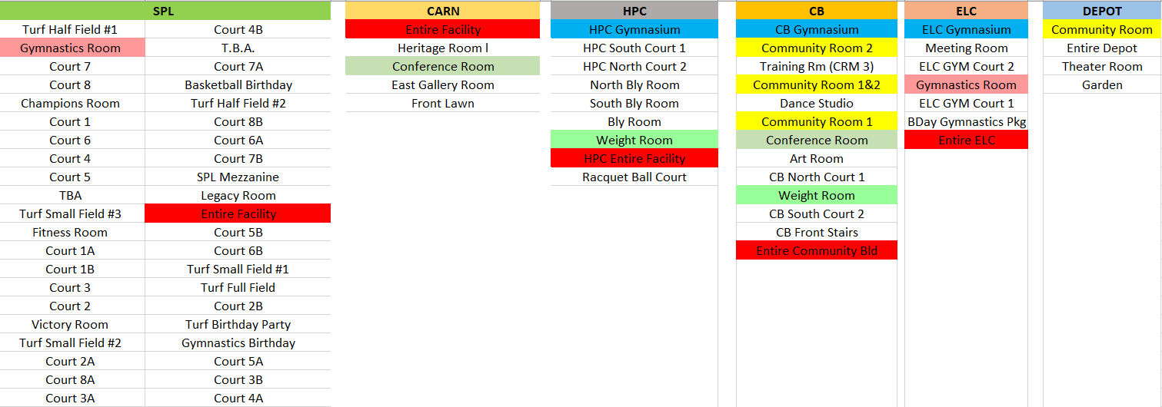

Common facilities

Slide 22
Challenges encountered with the dataset
The Provided Data is distributed across 69 files out of which 59 files are in PDF format and 10 are XLS files
The data Provided in the PDF are in calendar schedule format with different timings on each day
Extracting the data from these PDFs makes Data Pre-processing difficult and time taking process.
The extracted data need to be converted into Numerical format.

Slide 23
Tasks Distribution
Data extraction:- Eswar, Sudheer
Data Pre-processing:- Mowlika, Eswar, Sudheer
Python Coding:- Eswar, Mowlika, Sudheer
Visualization:- Eswar, Mowlika
Documentation:- Sudheer, Mowlika
Optional Comments: All the team members will be contributing to an extent in all the tasks, but their major part of contribution is mentioned as above.

Slide 24

Any Questions?

Slide 25

THANK YOU..!!

